Slide 1
NAMMA KADAI
Name: Karuppasamy.B
Mail Id: karuppusamylivak@gmail.com
Dept: IT
Karpagam Institute of Technology

Slide 2
Sign Up and Sign In Page
It was having two types of Sign In
One is user another one is admin
In sign up page it requires Name,Username and password
The UserName value should be distinct

Slide 3
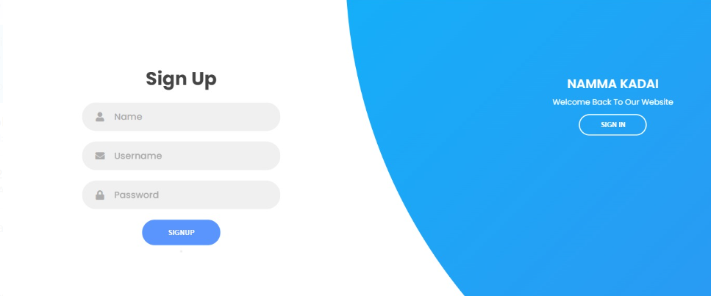
Sign Up

Slide 4
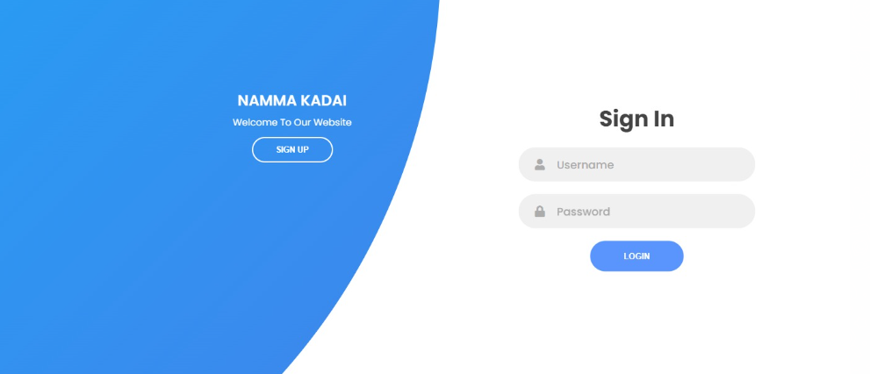
Sign In

Slide 5
Admin Page
It shows the product lists
It requires product id,name,price
we can add and remove the products

Slide 6
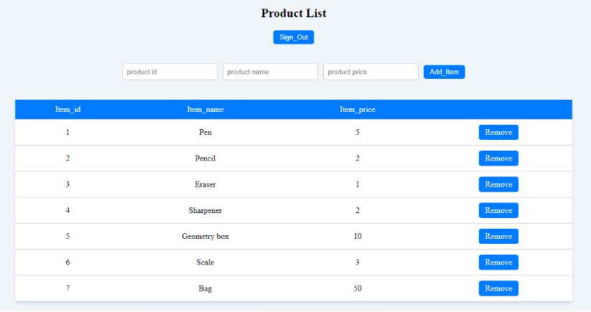
Product list and balance

Slide 7
User Page
It shows the account balance,stock list,purchased list,sales list purchased history and sales history
From the purchase list we can purchase the products and stored to stock list
From the sales list we can sale the products and stored to stock list
It shows the Account balance,purchase and sales history
We can remove the products from the stock list

Slide 8
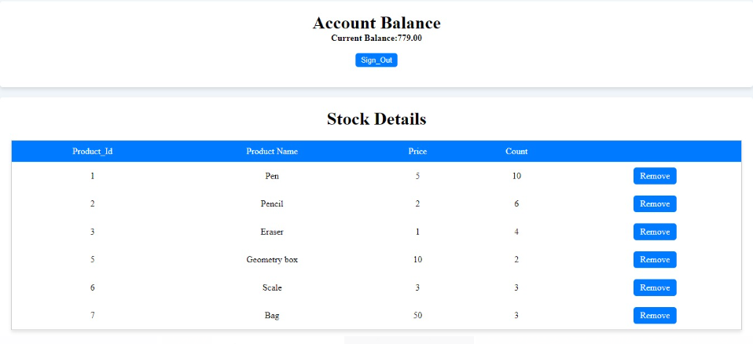
Account balance and Stock list

Slide 9
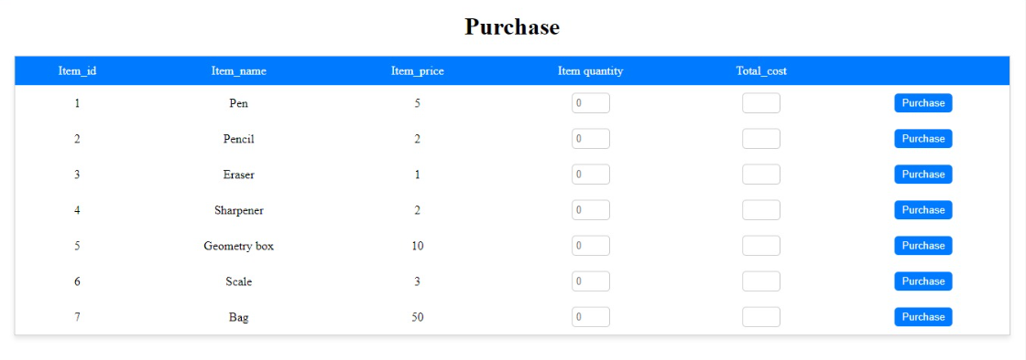
Purchase

Slide 10
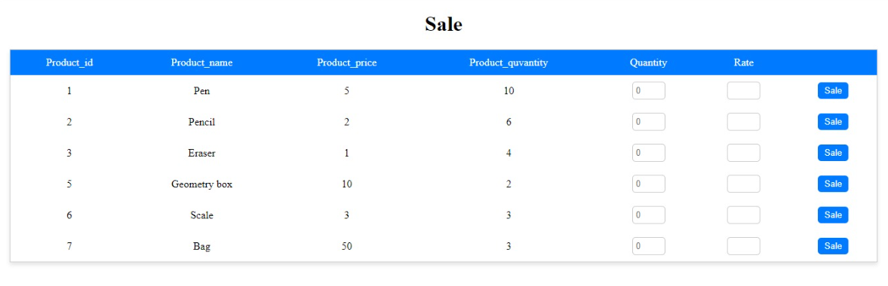
Sale

Slide 11
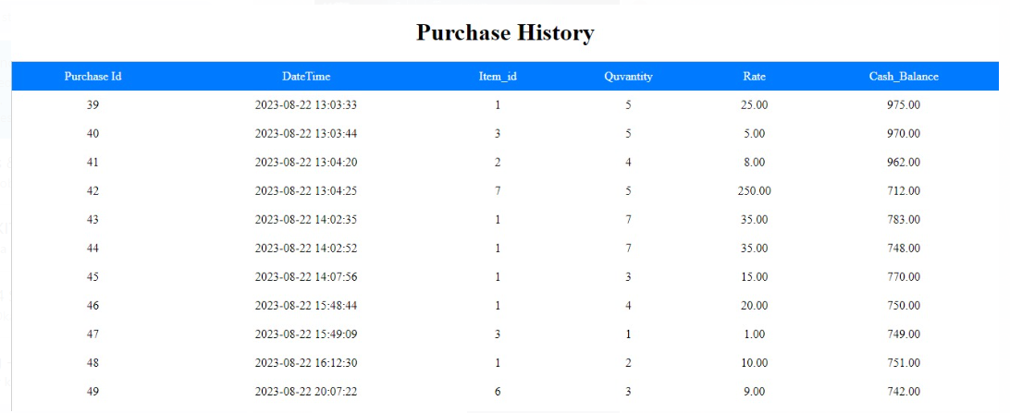
Purchase history

Slide 12
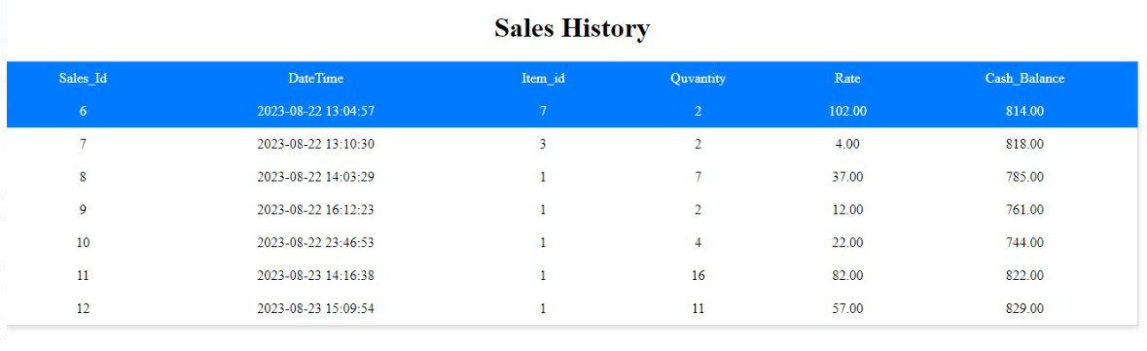
Sales History

Slide 13


